Slide 1
California Carbon Emissions and Impact on Wildfires
Joseph Barr

Slide 2
Purpose
Address the News
Discover the answers to the questions:
Has the increase in population of California effected the carbon emission of the state?
If this is assumed to be true how does this impact the frequency and destruction of wildfires?
Delve into the mystery of California wildfires and understand their destructive behaviors within a 16-year time period.

Slide 3
Background
Data provided by:
California Air Resources Board
National Interagency Fire Center
California Census
Carbon Emission
Number of Wildfires and Acres Destroyed
Population
Year range 2002-2017

Slide 4
Methods
Import datasets from Excel
Create variables based on the imported datasets
Graph all the variables with respect to time (in years)
Create 2-Dimensional matrices based on correlation of wanted variables
Find correlation
Plot the variables under consideration

Slide 5
Predictions
Population and Total Carbon Emissions will have relationship
Remaining variables will have no direct relationship

Slide 6
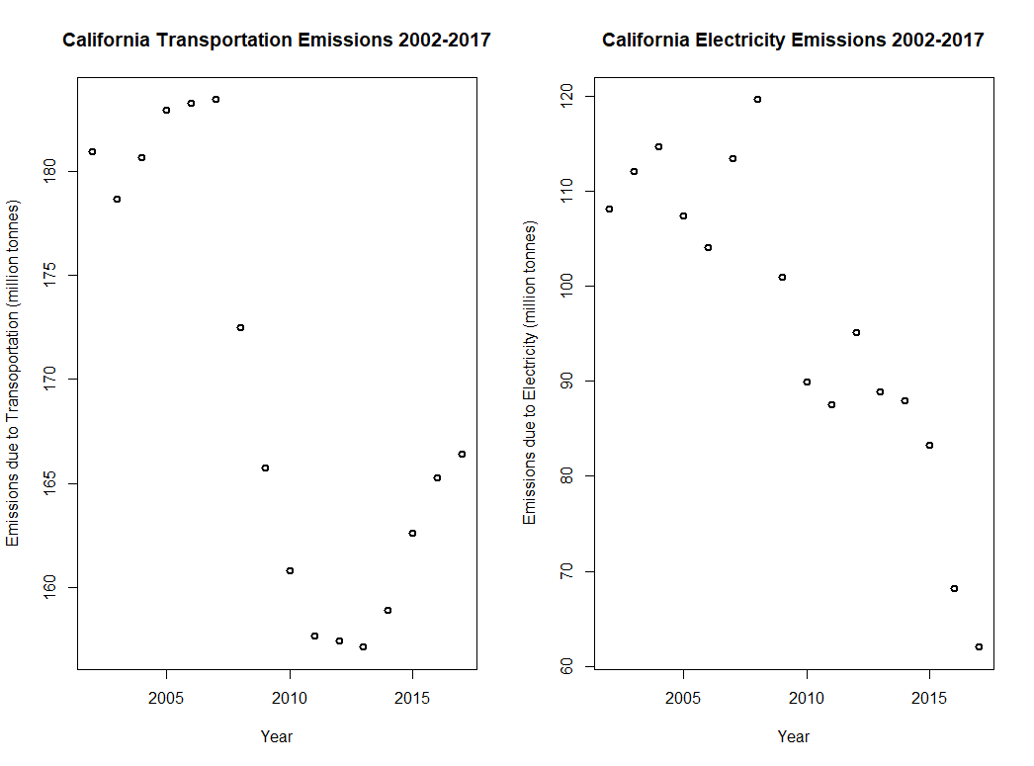
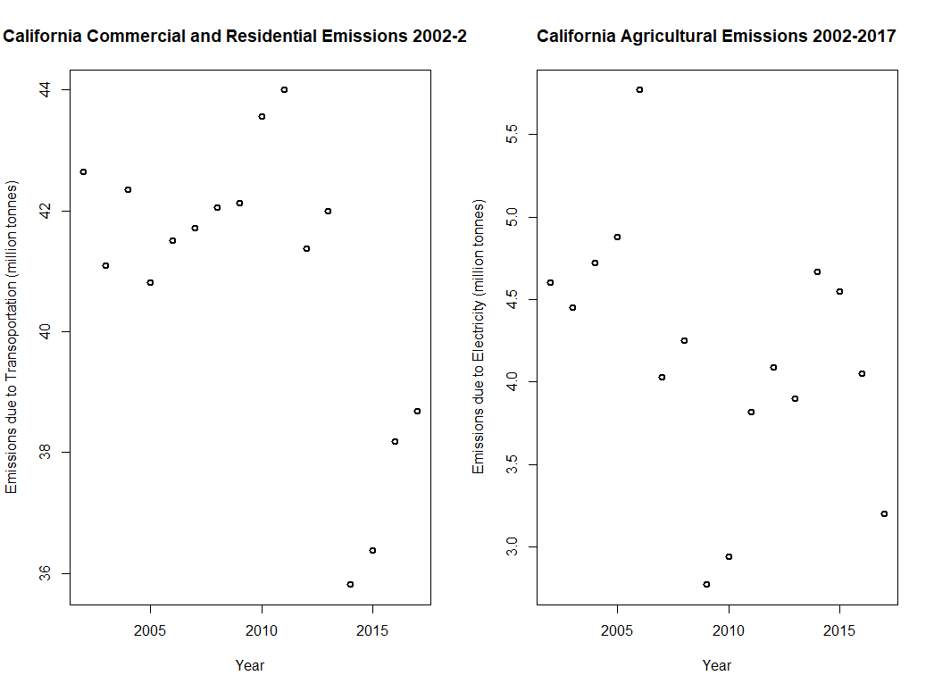
Graphs and Data

Slide 7
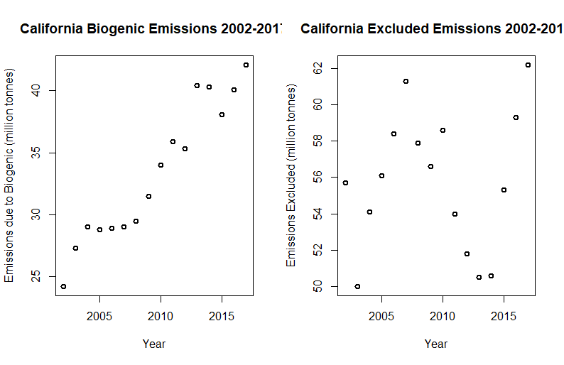
Graphs and Data

Slide 8
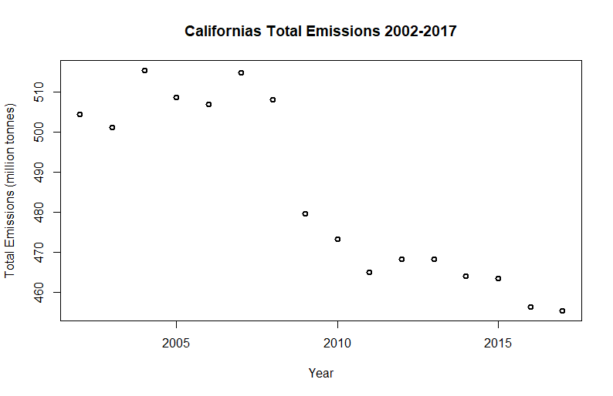
Graphs and Data

Slide 9
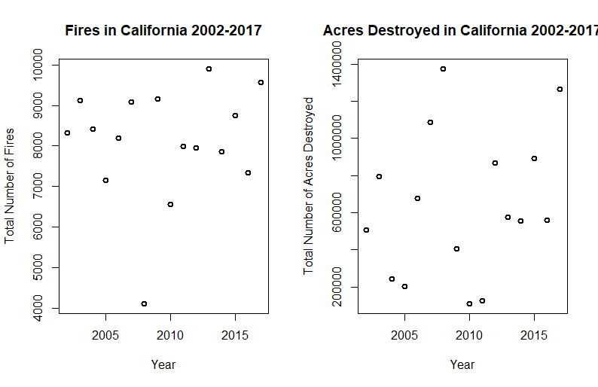
Graphs and Data

Slide 10
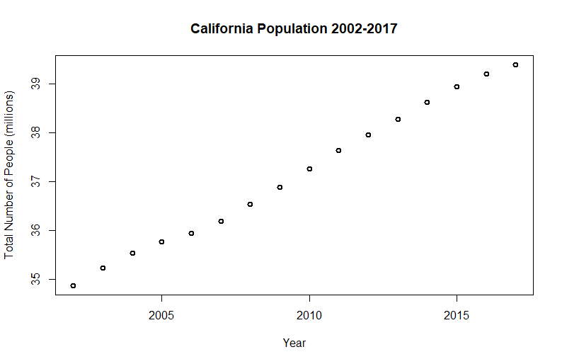
Graphs and Data

Slide 11
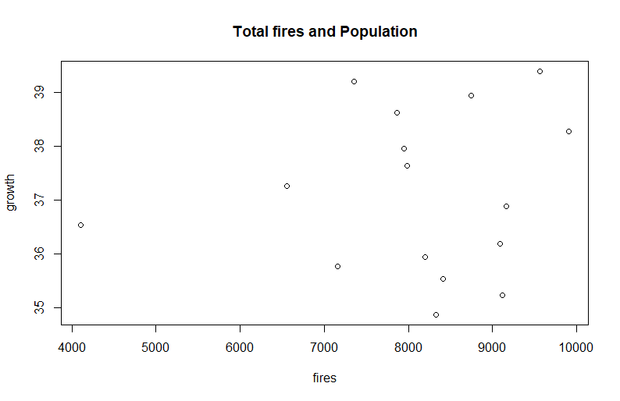
Correlations
Population and Number of Fires
.118

Slide 12
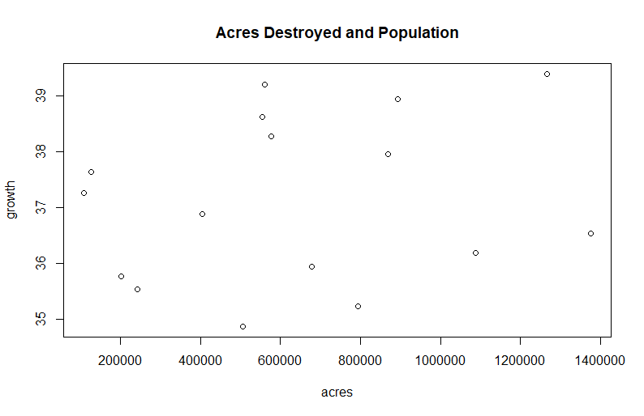
Correlations
Population and Acres Destroyed
0.205

Slide 13
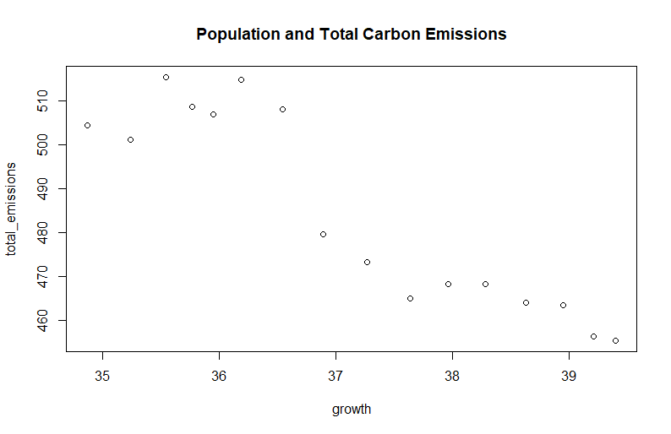
Correlations
Population and Total Carbon Emissions
-0.916

Slide 14
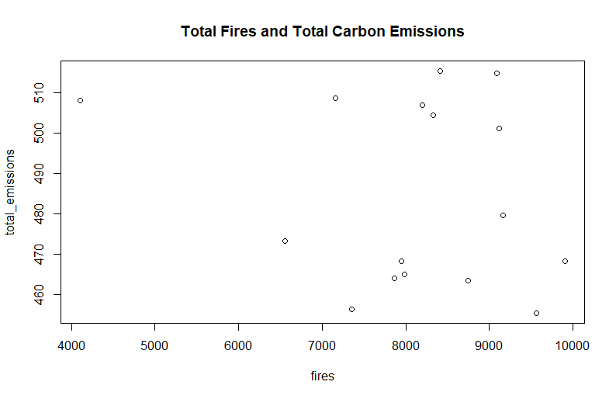
Correlations
Total Carbon Emissions and Total Fires
-0.202

Slide 15
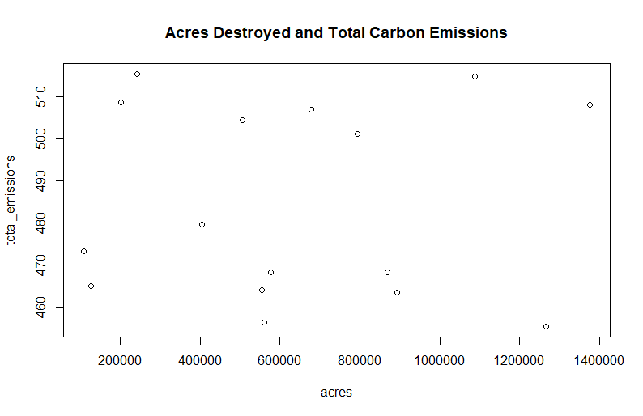
Correlations
Total Carbon Emissions and Acres Destroyed
0.280

Slide 16
Conclusions
Population and Total Carbon Emissions
Frequency and Destructivity of Fires
What went wrong?

